Slide 1
Introduction to Puppet
By Manish Sapariya
manish.sapariya@kpoint.com
@manishsapariya

Slide 2
who am I
Architect at kPoint Technologies Pvt Ltd.
kPoint :
Platform for creating videos easily which are deeply searchable
Distribute and track the usage of videos
Training, video based customer self service are some of use cases
Primary responsibilities are Testing of kPoint and managing kPoint services cloud.
http://tutorials.kpoint.com

Slide 3
who are you?
sysadmin / devops ?
developers ?
QA ?
How many of know or have used puppet / chef / other tool?

Slide 4


Slide 5
Agenda at glance
Why Puppet?
What is Puppet?
How Puppet does it?
How to Puppet?

Slide 6
Why Puppet?
Configuration management
time consuming
error-prone if manual
Infrastructure can be programmed
traditional approach
ad hoc
non-reusable
not scalable
inflexible
Enter the world of puppet
should I say one of the tools for infrastructure programming & management?
CFEngine, Puppet, Chef, Ansible

Slide 7
What is Puppet?
Puppet is a configuration management system that allows you to define the state of your IT infrastructure, then automatically enforces the correct state.
Portable
Reusable
Secure
Scalable
Open source, also has enterprise version
Is developed in Ruby, if you care
Has it’s own DSL to write configurations
This language is declarative, and is meant to be more configuration data than full programming—it most resembles Nagios's configuration format, but is also heavily influenced by CFEngine and Ruby

Slide 8
How Puppet does it?
Define
Define the desired state of the infrastructure’s configuration using Puppet’s declarative language
Simulate
Simulate configuration changes before enforcing them.
Enforce
Enforce the deployed desired state and correct any deviation
Report
Report the differences between actual and desired states and any changes made enforcing the desired state.

Slide 9
How to Puppet - Manifests
Puppet programs are called “manifests
Let’s look at one example puppet-manifest.pp

Slide 10
How to Puppet - RAL
RAL Resource Abstraction Layer
Resource types abstract resources like packages/services/cron…
Have title and attributes
Providers are the implementation of the platform specific types
e.g. yum/apt/ports for Package resource
Resources and Providers combined allows, users to define and enforce a state of the system (resources) in OS independent way
puppet describe –l (to list various kinds of resources defined on your machine)
puppet resource user (to list all the resources of type user)
puppet resource user root (to list the user root)

Slide 11
How to Puppet – classes & modules
classes one layer of abstraction over resources
Example mysql class
modules provide one layer of abstraction over modules

Slide 12
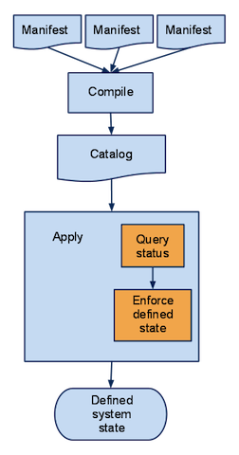
How to Puppet does it - Manifests

Slide 13
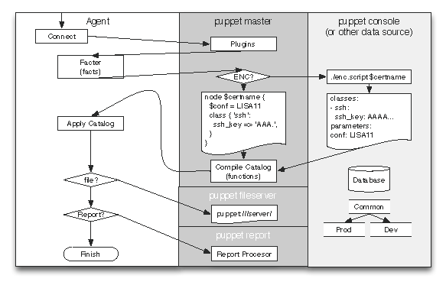
How to Puppet does it – Data flow

Slide 14
How Puppet does it - catalogue
a compilation of all the resources that will be applied to a given system and the relationships between those resources
Basically graph representation of the resources
importantly relationship or dependencies amongst the resources
gives puppet capability to configure rest of the system in case of failures
Puppet can actually create the dependency graph in dot format.

Slide 15
How to Puppet - Facter
System inventory tool
Collects the agent information called facts
Example facts
architechture => x86_64
operatingsystem => ubuntu
kernel => Linux
normalizes it into a set of variables, and passes them off to Puppet
Puppet’s compiler then has access to those facts when it’s reading a manifest

Slide 16
How to Puppet - Hiera
a key/value lookup tool for configuration data
Helps separate data from the manifests
This makes it:
Easier to configure your own nodes: default data with multiple levels of overrides is finally easy.
Easier to re-use public Puppet modules: don’t edit the code, just put the necessary data in Hiera.
Easier to publish your own modules for collaboration: no need to worry about cleaning out your data before showing it around, and no more clashing variable name

Slide 17
How to Puppet – Deployment
single server
client server

Slide 18
How to Puppet – Testing
puppet rspec
Puppet specific rspec examples and expectation matchers
Basically creates a catalogue from the given classes and facts and asserts various expectations
puppet beaker
Integration tests by actually running on manifests as tests
Uses vagrant as the virtualization platform to run actual tests

Slide 19
Somewhat more advanced concepts
Virtual resource/exported resources
Add new hosts automatically in nagios’s monitoring list
ENCs
External node classifiers
Allows you to manage the node configuration in external system (script, LDAP) instead of the manifests files

Slide 20
Benefits of Puppet.
Infrastructure as code
Editing and refactoring tool
Version control
Tests
Unit (rspec)
Integration/system (beaker)

Slide 21
References
http://prezi.com/p6f8bz9a3ayz/introduction-to-puppet
https://puppetlabs.com/presentations/designing-puppet-rolesprofiles-pattern
http://www.puppetcookbook.com/
http://www.aosabook.org/en/puppet.html

Slide 22
Feedback
What do you think I should have included?
What do you think I could have omitted?
What will you like to hear about next?

Slide 24


